Slide 1
VPN Lab
Zutao Zhu
03/26/2010

Slide 2
Outline
VPN
VPN Setup in VMWare
VPN tasks
OpenSSL
How to Write Socket Programs using OpenSSL APIs

Slide 3
VPN
Virtual Private Network
  Create a private scope of computer communication
  Provide a secure extension of a private network into an unsecure network, Internet
  Built on IPSec or Secure Socket Layer (SSL)

Slide 4
VPN
Three types
  Host-to-Host Tunnel
  Host-to-Gateway Tunnel
  Gateway-to-Gateway Tunnel

Slide 5
Tun/tap Interface
virtual network kernel drivers
software-only interfaces, that is, they exist only in the kernel
no physical hardware component
Have a special file descriptors
a tap interface outputs (and must be given) full ethernet frames
a tun interface outputs (and must be given) "raw" IP packets

Slide 6
Tun/tap Interface (cont.)
When a program is attached to a TUN/TAP interface, the IP packets that the computer sends to this interface will be piped into the program;
the IP packets that the program sends to the interface will be piped into the computer, as if they came from the outside through this virtual network interface

Slide 7
Tun/tap Interface (cont.)
IP addresses can be assigned
traffic can be analyzed
routes pointing to it can be established

Slide 8
Tun/tap Setup
Call tun_alloc() to create the tun/tap interface in program
Configure the tun/tap interface (ifconfig)
Enable the tun/tap interface (ifconfig)
Set the routing rules (route add)
Use the tunnel (any tool, like ping, ssh, etc.)

Slide 9
Your First Task
Build a UDP tunnel
Explain why TCP over TCp is not good

Slide 10
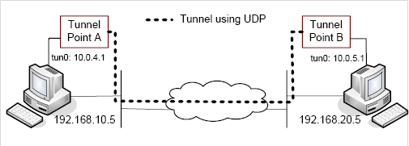
Host-to-Host Tunnel
Use UDP

Slide 11
Host-to-Gateway Tunnel
Use two physical machines, one acting as a host, the other acting as the gateway, which has many other virtual machines
Use Port Forwarding to make certain port of the VM accessible to the outside
VMWare Setup
Gateway Setup
Host Setup

Slide 12
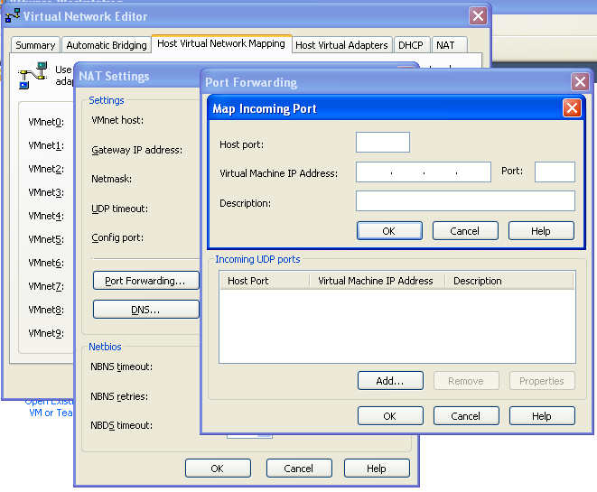
VMWare Port Forwarding on the host machine of Gateway

Slide 13
Gateway Setup
On one physical machine, we use one virtual machine as the gateway, the others as the internal hosts
Gateway Setup
  Add another interface
  Enable IP forwarding feature
  Configure the routing table for gateway

Slide 14
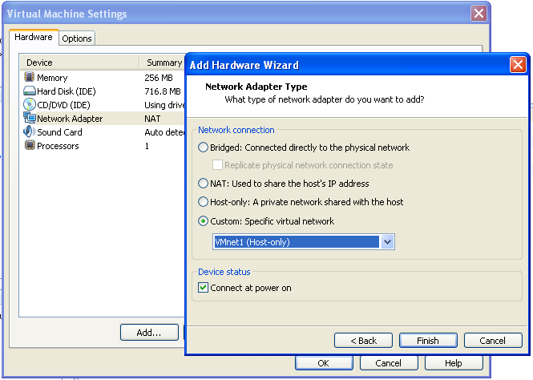
Add Another Interface for Gateway

Slide 15
IP forwarding
$ sudo sysctl net.ipv4.ip_forward=1

Slide 16
Add Routing Rules
man route – read the route manual page
Use route add, example
$ sudo route add -net 10.0.10.0 netmask 255.255.255.0 gw 10.0.20.1

Slide 17
Host Setup
You have to configure the routing table by yourself
Similar with the previous slide

Slide 18
Your second task
Make sure Host-to-Gateway tunnel works
On host in one physical machine, you can ping/telnet/ssh/ftp any IP behind the Gateway on the other physical machine

Slide 19
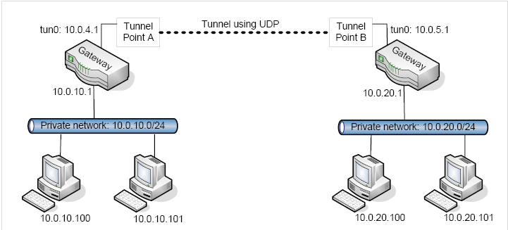
Gateway-to-Gateway Tunnel

Slide 20
Your third task
Make sure Gateway-to-Gateway tunnel works
On one host behind the Gateway in one physical machine, you can ping/telnet/ssh/ftp any IP behind the Gateway on the other physical machine

Slide 21
OpenSSL
Prepare work
  apt-get source openssl
  ./config
  make
  make install
Directory of headers and libraries
  /usr/local/ssl/include
  /usr/local/ssl/lib

Slide 22
What OpenSSL does
Encrypt/decrypt
Hash
Create certificates
APIs

Slide 23
Demo
Client/server program with OpenSSL

Slide 24
Header Files
/* OpenSSL headers */
#include "openssl/bio.h"
#include "openssl/ssl.h"
#include "openssl/err.h"
/* Initializing OpenSSL */
SSL_load_error_strings();
ERR_load_BIO_strings();
OpenSSL_add_all_algorithms();

Slide 25
Creating and opening a connection
BIO * bio;
bio = BIO_new_connect("hostname:port");
if(bio == NULL)
{
/* Handle the failure */
}
if(BIO_do_connect(bio) <= 0)
{
/* Handle failed connection */
}

Slide 26
Reading from the connection
int x = BIO_read(bio, buf, len);
if(x == 0)
{
/* Handle closed connection */
}
else if(x < 0)
{
if(! BIO_should_retry(bio))
{
/* Handle failed read here */
}
/* Do something to handle the retry */
}

Slide 27
Writing to the connection
if(BIO_write(bio, buf, len) <= 0)
{
if(! BIO_should_retry(bio))
{
/* Handle failed write here */
}
/* Do something to handle the retry */
}

Slide 28
Closing the connection
/* To reuse the connection, use this line */
BIO_reset(bio);
/* To free it from memory, use this line */
BIO_free_all(bio);

Slide 29
Setting up a secure connection
Secure connections require a handshake after the connection is established.
the server sends a certificate to the client
the client then verifies against a set of trust certificates
It also checks the certificate to make sure that it has not expired
a trust certificate store be loaded prior to establishing the connection
The client will send a certificate to the server only if the server requests one

Slide 30
Setting up the SSL pointers
if(! SSL_CTX_load_verify_locations(ctx, "/path/to/TrustStore.pem", NULL))
{
/* Handle failed load here */
}

Slide 31
Preparing a certificate folder and using it
/* Use this at the command line */
c_rehash /path/to/certfolder
/* Then call this from within the application */
if(! SSL_CTX_load_verify_locations(ctx, NULL, "/path/to/certfolder"))
{
/* Handle error here */
}

Slide 32
Setting up the BIO object
bio = BIO_new_ssl_connect(ctx);
BIO_get_ssl(bio, & ssl);
SSL_set_mode(ssl, SSL_MODE_AUTO_RETRY);

Slide 33
Opening a secure connection
/* Attempt to connect */
BIO_set_conn_hostname(bio, "hostname:port");
/* Verify the connection opened and perform the handshake */
if(BIO_do_connect(bio) <= 0)
{
/* Handle failed connection */
}

Slide 34
Checking if a certificate is valid
if(SSL_get_verify_result(ssl) != X509_V_OK)
{
/* Handle the failed verification */
}

Slide 35
Cleaning up the SSL context
SSL_CTX_free(ctx);

Slide 36
References
http://waldner.netsons.org/d2-tuntap.php
http://www.mjmwired.net/kernel/Documentation/networking/tuntap.txt
http://waldner.netsons.org/d2-tuntap.php
http://sites.inka.de/~W1011/devel/tcp-tcp.html
http://waldner.netsons.org/d3-ssh-tuntap.php
http://www.madboa.com/geek/openssl/

Slide 37
Reference
http://www.securityfocus.com/infocus/1466
http://www.ibm.com/developerworks/linux/library/l-openssl.html
http://www.securityfocus.com/infocus/1388
http://www.securityfocus.com/infocus/1462

